Slide 1
Behaviorism
B. F. Skinner

Slide 2
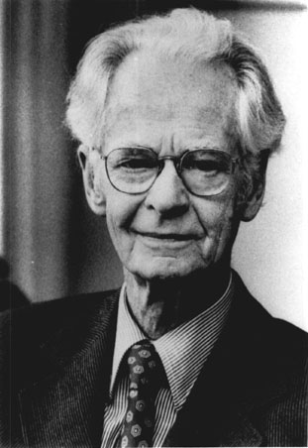
B.F. Skinner (1904-1990)

Slide 3
B. F. Skinner
(1904-1990)
Skinner’s life
Predetermined, lawful, and orderly
A product of past reinforcements
1925: Hamilton College (NY): degree in English, no courses in psychology
Read about Pavlov’s and Watson’s experimental work
1931: Ph.D. from Harvard

Slide 4
B. F. Skinner
Dissertation: a reflex is a correlation between
S and R
1938: The Behavior of Organisms
1953: Science and Human Behavior
1990: Vigorously attacked the growth of cognitive
psychology
1990 (final article): "Can Psychology Be a Science
of Mind?"

Slide 5
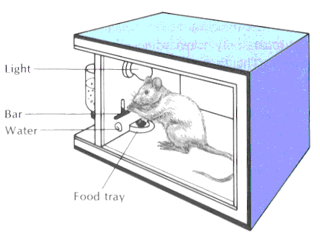
B. F. Skinner
Operant behavior: occurs without an observable external stimulus
Operates on the organism’s environment
The behavior is instrumental in securing a stimulus more representative of everyday learning

Slide 6
B. F. Skinner
Science of behavior: Study of conditioning and extinction of operants
Dependent variable in the "Skinner box": rate of response
Law of acquisition
key variable: reinforcement
practice provides opportunities for
additional reinforcement
Differs from Thorndike and Hull’s positions
Thorndike and Hull: explanatory
Skinner: strictly descriptive

Slide 7
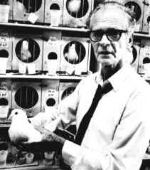

Slide 8
Skinner’s Theory
“All we need to know in order to describe and explain behavior is this: actions followed by good outcomes are likely to recur , and actions followed by bad outcomes are less likely to recur.” (Skinner, 1953)

Slide 9
Central Human Motive in Skinner’s Theory
Environmental consequences shape behavior

Slide 10
Laboratory Examples
Operant Conditioning
Exploring
Scratching
Key-pecking
Grooming
Defecating
Urinating
Pigeon
Reinforcement
(in a Skinner box)
(food pellet)

Slide 11
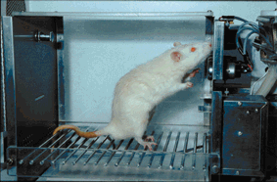

Slide 12
OPERANT CONDITIONING TECHNIQUES
POSITIVE REINFORCEMENT = increasing a behavior by administering a reward
NEGATIVE REINFORCEMENT = increasing a behavior by removing an aversive stimulus when a behavior occurs
PUNISHMENT = decreasing a behavior by administering an aversive stimulus following a behavior OR by removing a positive stimulus
EXTINCTION = decreasing a behavior by not rewarding it

Slide 13
B. F. Skinner
Research foci
Role of punishment in response acquisition
Schedules of reinforcement
Extinction of operants
Secondary reinforcement
Generalization
Subjects included humans as well as animals

Slide 14
B. F. Skinner
Schedules of reinforcement
Reinforcement is necessary in operant behavior
Reinforcement schedules
continuous
fixed and variable
ratio and interval

Slide 15
SCHEDULES OF REINFORCEMENT
Interval schedules: reinforcement occurs after a certain amount of time has passed
Fixed Interval = reinforcement is presented after a fixed amount of time
Variable Interval = reinforcement is delivered on a random/variable time schedule
Ratio schedules: reinforcement occurs after a certain number of responses
Fixed Ratio = reinforcement presented after a fixed # of responses
Variable Ratio = reinforcement delivery is variable but based on an overall average # of responses

Slide 16
LIMITED EFFECTS OF PUNISHMENT
Punishment does not teach appropriate behaviors
Must be delivered immediately & consistently
May result in negative side effects
Undesirable behaviors may be learned through modeling (aggression)
May create negative emotions (anxiety & fear)

Slide 17
HOW COMPLEX BEHAVIORS
ARE LEARNED
Successive approximation/shaping = reinforcing behaviors as they come to approximate the desired behavior
Superstitious Behavior = when persistent behaviors are reinforced coincidentally rather than functionally
Self-control of behavior
    Stimulus avoidance
    Self-administered satiation
    Aversive stimulation
    Self-reinforcement

